Slide 1
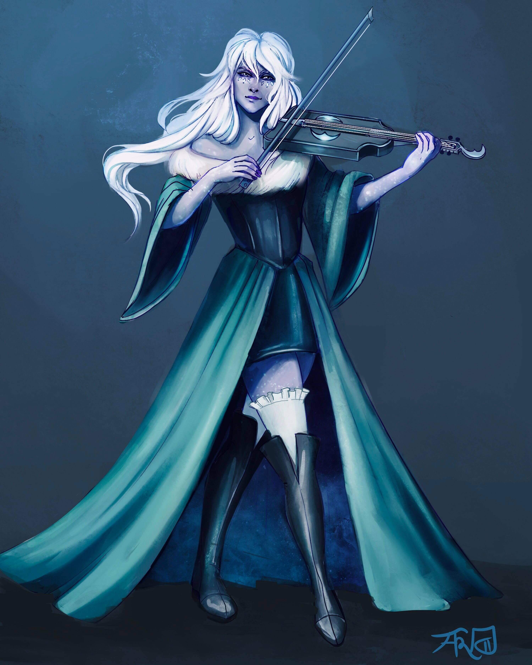
Bethany de Bolbec
Half Elf
Assistant at the Day Dream Library
Loves to play Viola and wants to prove her worth by joining the Flatcoat Circus.
Currently in a relationship with Desparia.
Level 2 - Bard
STR | DEX | CON | INT | WIS | CHA
3 (-5) | 14 (+2) | 11 (+0) | 13 (+1) | 8 (-1) | 17 (+3)
Notes:
1 - Bethany de Bolbec
2 - Penguin Varaati
3 - Antinua Dankil
4 - Adrik Dankil
5 - Myev
6 - Ander High-Hill & Milo Silvereyes
7 - Arveene Amblecrown
8 - Eke

Slide 2
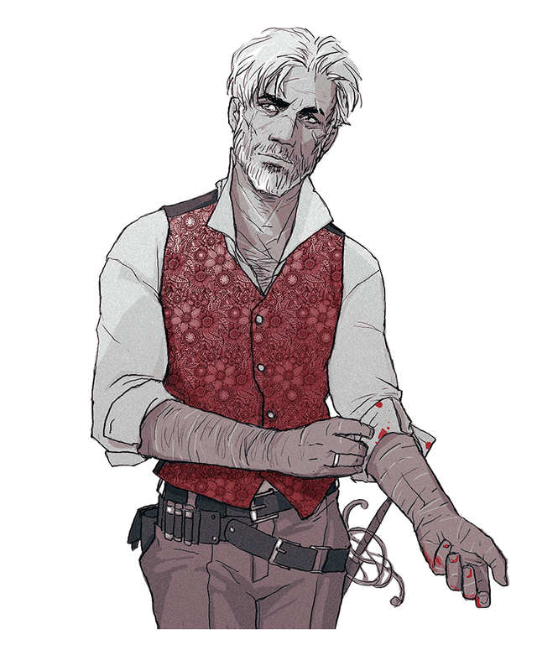
Penguin Varaati/???
Half-Elf
Adopted brother of Rhino’s Family
Very protective over Rhino, and “good” at calming him down.
Warlock gaining power from the left hand to Verrona’s God.
Having some personal time to think over the experience he had with Rhino.
Level 3 - Warlock
STR | DEX | CON | INT | WIS | CHA
11 (+0) | 18 (+4) | 12 (+1) | 17 (+3) | 12 (+1) | 19 (+4)
Notes:
1 - Bethany de Bolbec
2 - Penguin Varaati
3 - Antinua Dankil
4 - Adrik Dankil
5 - Myev
6 - Ander High-Hill & Milo Silvereyes
7 - Arveene Amblecrown
8 - Eke

Slide 3
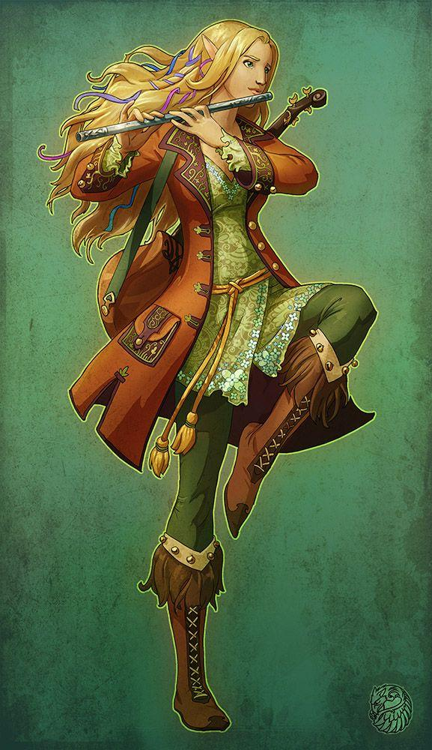
Antigua Dankil
Elf
Likes to be called Anti.
Loving adopted mother of Wyrin.
Notes:
1 - Bethany de Bolbec
2 - Penguin Varaati
3 - Antinua Dankil
4 - Adrik Dankil
5 - Myev
6 - Ander High-Hill & Milo Silvereyes
7 - Arveene Amblecrown
8 - Eke

Slide 4
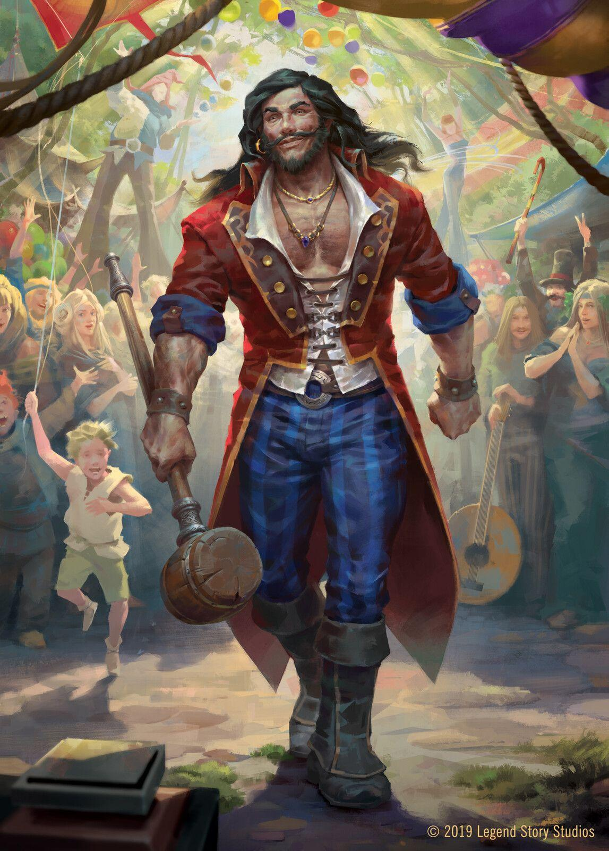
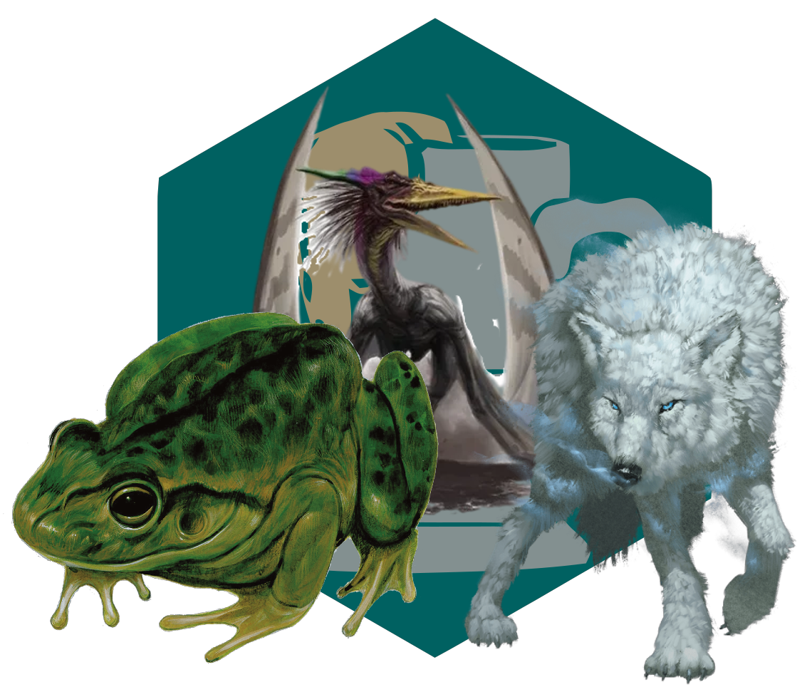
Adrik Dankil
Human
Loving adopted father of Wyrin.
Owns a Wolf named Bear, Giant Frog named Bertha and a Pteranodon named Floop.
Notes:
1 - Bethany de Bolbec
2 - Penguin Varaati
3 - Antinua Dankil
4 - Adrik Dankil
5 - Myev
6 - Ander High-Hill & Milo Silvereyes
7 - Arveene Amblecrown
8 - Eke

Slide 5
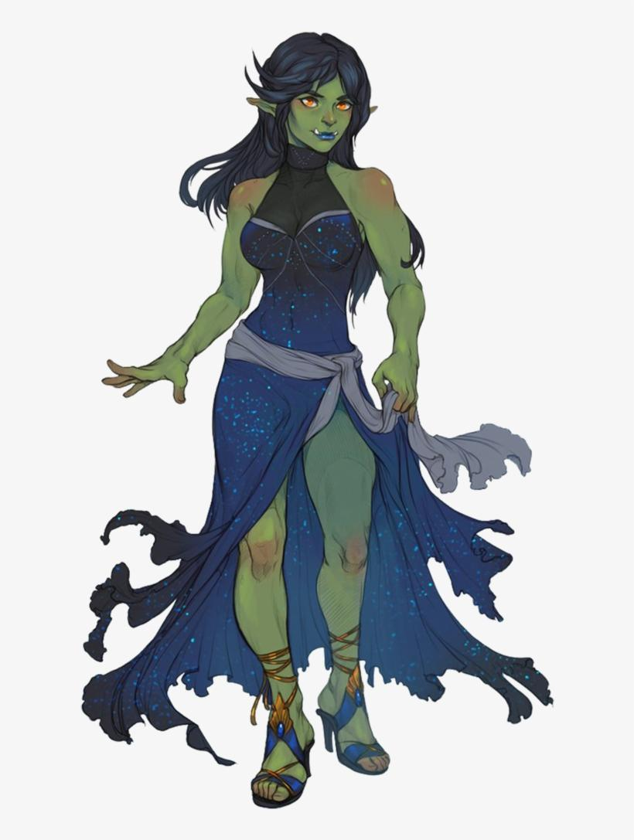
Myev
Half Orc
Loving sister of Wyrin who protects her from bullies due to being bullied as a child.
Notes:
1 - Bethany de Bolbec
2 - Penguin Varaati
3 - Antinua Dankil
4 - Adrik Dankil
5 - Myev
6 - Ander High-Hill & Milo Silvereyes
7 - Arveene Amblecrown
8 - Eke

Slide 6
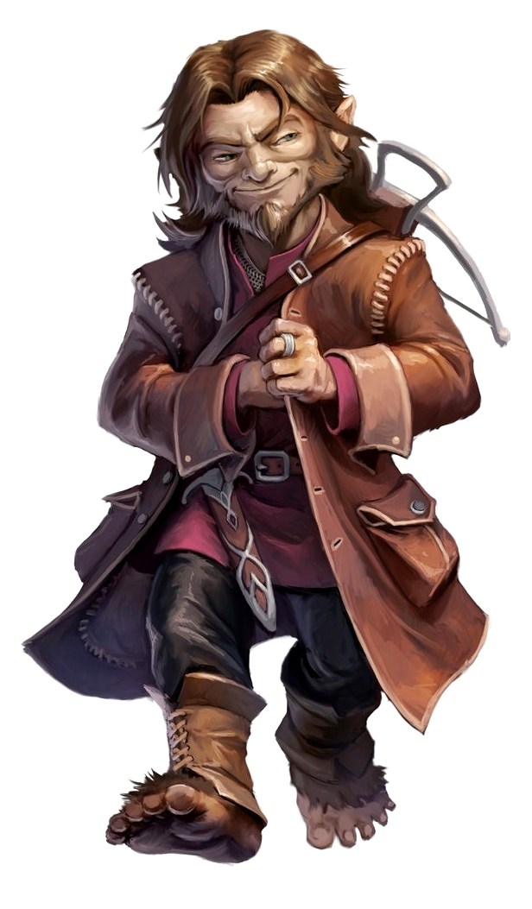
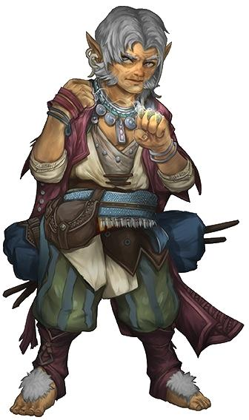
Ander High-Hill & Milo Silvereyes
Halflings
Are in a beautiful relationship together.
Taught Wyrin lots of things about being halflings and perhaps a little bit of sleight of hand.
Notes:
1 - Bethany de Bolbec
2 - Penguin Varaati
3 - Antinua Dankil
4 - Adrik Dankil
5 - Myev
6 - Ander High-Hill & Milo Silvereyes
7 - Arveene Amblecrown
8 - Eke

Slide 7
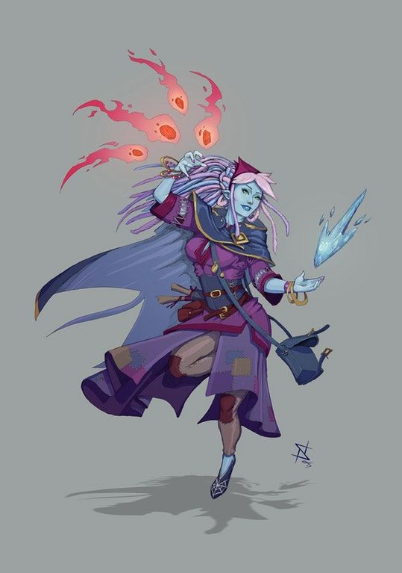
Arveene Amblecrown
Water Genasi
New member of the Flatcoat Circus joined while Wyrin left.
Notes:
1 - Bethany de Bolbec
2 - Penguin Varaati
3 - Antinua Dankil
4 - Adrik Dankil
5 - Myev
6 - Ander High-Hill & Milo Silvereyes
7 - Arveene Amblecrown
8 - Eke

Slide 8
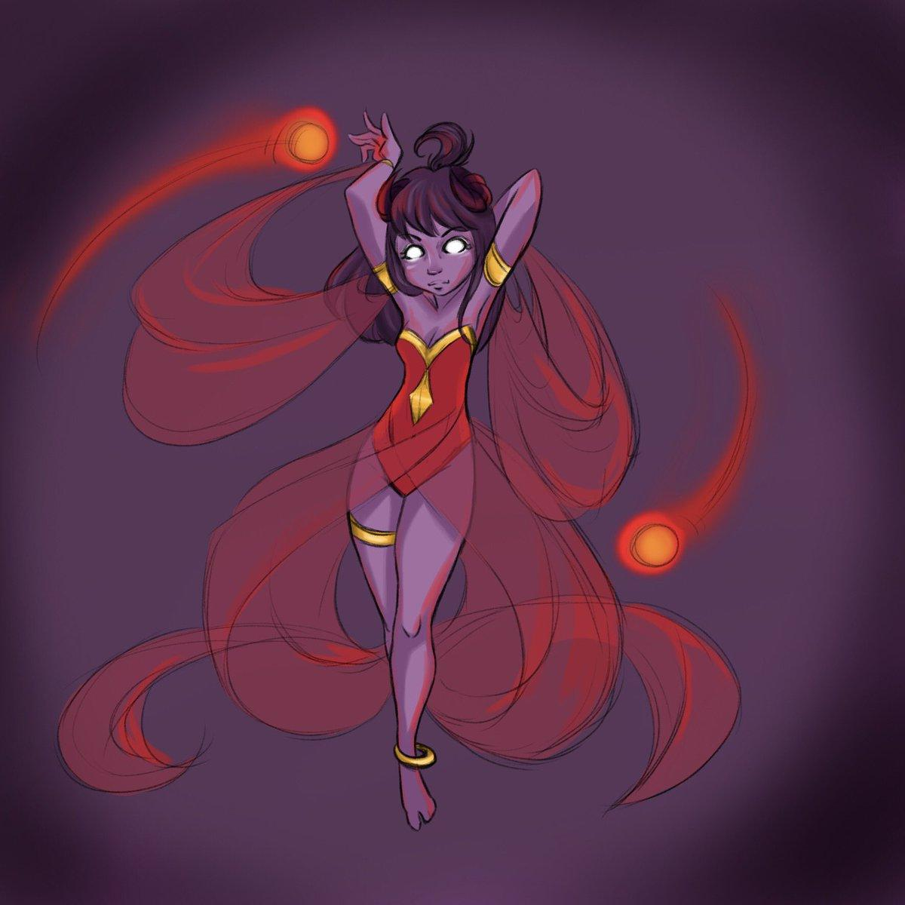
Eke
Tiefling
Sister to Wyrin, who she also despises.
Notes:
1 - Bethany de Bolbec
2 - Penguin Varaati
3 - Antinua Dankil
4 - Adrik Dankil
5 - Myev
6 - Ander High-Hill & Milo Silvereyes
7 - Arveene Amblecrown
8 - Eke

